Slide 1

Process Mining Virtual Internship
by
S Sarfaraaz Ahmed
Roll No. 214G1A3297
Department of Computer Science and Engineering (Data Science)
Srinivasa Ramanujan Institute of Technology
(Affiliated to JNTUA & Approved by AICTE) (Accredited by NAAC with ‘A’ Grade & Accredited by NBA (EEE, ECE & CSE)
Rotarypuram Village, B K Samudram Mandal, Ananthapuramu – 515701.
2023 - 2024

Slide 2

Contents
Course Objective
Introduction
Technology
Applications
Modules
Real Time applications
Learning outcomes
GitHub Link
Queries

Slide 3
Course Objective
The Course explains the key analysis techniques in process mining. We get to learn various process discovery algorithms.
Process Mining is the technology at the heart of the Celonis Execution Management System(EMS). enabling enterprises to fully understand how their core business processes run and find the hidden value opportunities, before taking intelligent, automated action to improve performance and unlock hundreds of millions across the enterprises.
Process mining applies data science to discover, validate and improve workflows. By combining data mining and process analytics, organizations can mine log data from their information systems to understand the performance of their processes.

Slide 4
Introduction
What is Process Mining?
Process mining is a data-driven approach that uses event data recorded in information systems to analyze, visualize, and improve business processes. It leverages techniques from data mining, process modeling, and business process management to provide insights into how processes are executed within an organization.
Process Mining is the combination of two disciplines: Data Science and Business Process Management. Process Mining essentially uses Data Science techniques, such as Big Data and AI, to address Process Science problems such as process improvement and automation.
Process Mining sits at the intersection of business process management(BPM) and data mining. while process mining and data mining both work with data, the scope of each dataset differs

Slide 5
Intro..
It encompasses several techniques that help organizations analyze event data and gain insights into their business processes. These techniques enable organizations to discover, understand, and improve their processes.
It is an analytical discipline for discovering, monitoring, and improving processes as they are Process Mining works by extracting knowledge from event logs (also called digital footprints) readily available in today’s information systems, to visualize business processes and their variations.

Slide 6
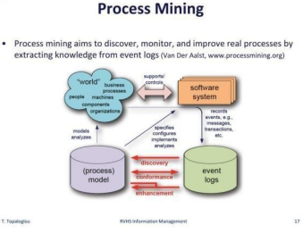
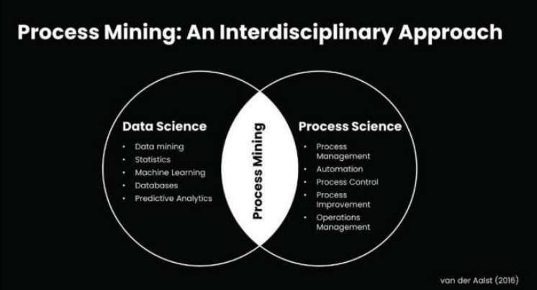
Intro..

Slide 7
Technology
Process Mining is a product of both data mining and business process management, so it involves various technologies that are part of these two fields.
Database systems are used for storing and managing event logs, which are converted into process models.
Technologies to extract, transform, and load event data from various IT systems within an organization.
RPA(robotic process automation) can be incorporated into process mining since process mining can pinpoint repetitive and rule-based tasks which are enough requirements to implement RPA.
The Celonis Execution Management System provides companies a modern way to run their business processes entirely on data and intelligence. It's comprised of execution instruments, execution applications, a developer studio, and an EMS store, all built on top of the Celonis EMS platform.

Slide 8
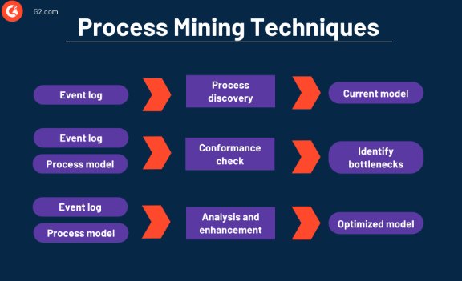
contd..
Process mining techniques benefit companies of any size and workflow. Process mining solutions can focus on various elements like the flow of a process, the organizational or time management with data mining and machine learning integration.
There are three main classes of process mining techniques:
Process Discovery
Conformance Check
Analysis and Enhancement

Slide 9
Applications
Process mining techniques have been used to improve process flows across a wide variety of industries
Healthcare: Process Mining provides recommendations for reducing the treatment processing time of patients
Financial Services: In the financial industry, process mining can be used to optimizeloan approval processes, fraud detection, and compliance monitoring. It helps identify irregular patterns and deviations from expected process behavior.
Information Technology: IT processes can be analyzed to improve system deployment, software development, and help desk operations. Process mining aids in identifying opportunities for automation, reducing downtime, and optimizing IT servicemanagement.
E-commerce: It can provide insight into buyer behaviours and provide accurate recommendations to increase sales.

Slide 10
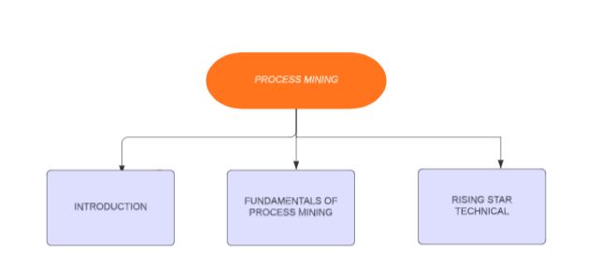
Modules

Slide 11
Contd..
Module 1: Introduction to Process Mining
Process Mining offers a data-driven and therefore more objective and holistic approach to understanding business processes. As a result, Process Mining has come to dominate a large majority of operational excellence, automation, and digitalization ambitions within industry.
Process Mining is the leading new technology when it comes to talking about algorithmic businesses - in other words, businesses that use algorithms and large amounts of real-time data to create business value. This has only become possible through the advent of information systems and administrative tools (e.g. Enterprise Resource Planning or Customer Relationship Management systems) which provide as good data source for process analytics.

Slide 12
Contd..
Module 2 : Fundamentals of Process Mining
The key Fundamentals of process mining refer to the core concepts and principles that underlie the analysis and improvement of business processes using process mining techniques. It involves extracting insights from event data to understand how processes function, identifying bottlenecks, inefficiencies, and opportunities for optimization.
The process mining fundamentals are :
Variant explorer
Process Explorer
Charts

Slide 13
contd..
Variant Explorer: It is a Celonis EMS Analysis tool that helps you explore how a specific process flows through your organization.
Variant Explorer gives you a quick way to see whether most process cases follow an acceptable flow of activities or not and helps you develop your first analysis questions.
Process Explorer: It is another analysis tool to use when taking an exploratory approach. It is especially useful for quickly revealing activities beyond the most common ones.
In the Process Explorer, if you display the Throughput Time KPI, you are looking at the time it took all the cases in the analysis to go directly between the two displayed activities.

Slide 14
contd..
Charts: You can visually display your data using area, bar, line, lollipop, scatter plot, and stacked charts in your studio view. Each chart type can then be customized further, giving you control over their look and feel.
Types of charts
Area
Bar
Line
Lollipop
Scatterplot
KPI

Slide 15
Contd..
Module 3: Rising Star Technical
It is essential for Process Mining users to formalize their process questions as executable queries. For this purpose, we present the Celonis Process Query Language (Celonis PQL), which is
•a domain-specific language
•tailored towards a particular process data model and
•designed for business users.
Celonis PQL Engine: Celonis PQL is an integral component of the Celonis Software Architecture. All Celonis applications use this language to query data from a data model. Celonis PQL engine is a database system which evaluates Celonis PQL queries over a defined data model.

Slide 16
contd..
Metadata is data about the data or documentation about the information which is required by the users. Metadata allow users access to help understand the content and find data.
PQL Queries: PQL enables the user to translate process-related business questions into queries, which are then executed by a custom-built query engine.Its syntax is inspired by SQL, but specialized for process-related queries.
PQL is a declarative language that is based upon temporal logic. Temporal logic is an extension of traditional propositional logic with operators that refer to the behavior of systems over time. These behavioral operators, called predictes in PQL, provide PQL with a mathematically precise means for expressing properties about the relation between activities and events in process instances.

Slide 17
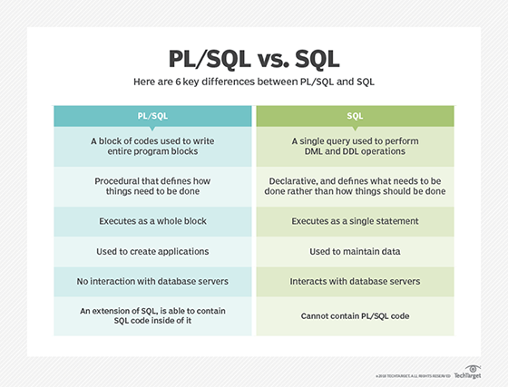
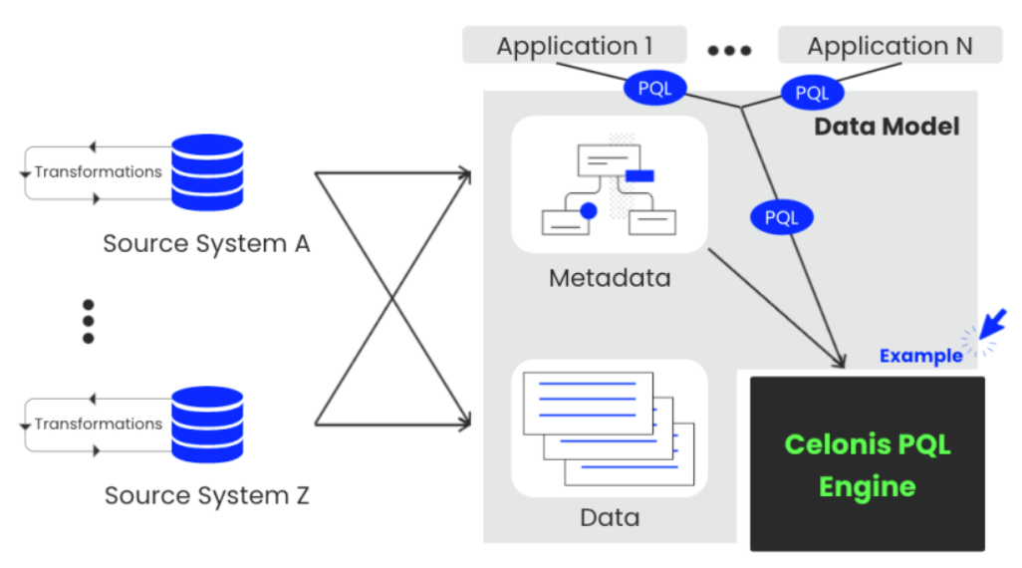
contd..

Slide 18
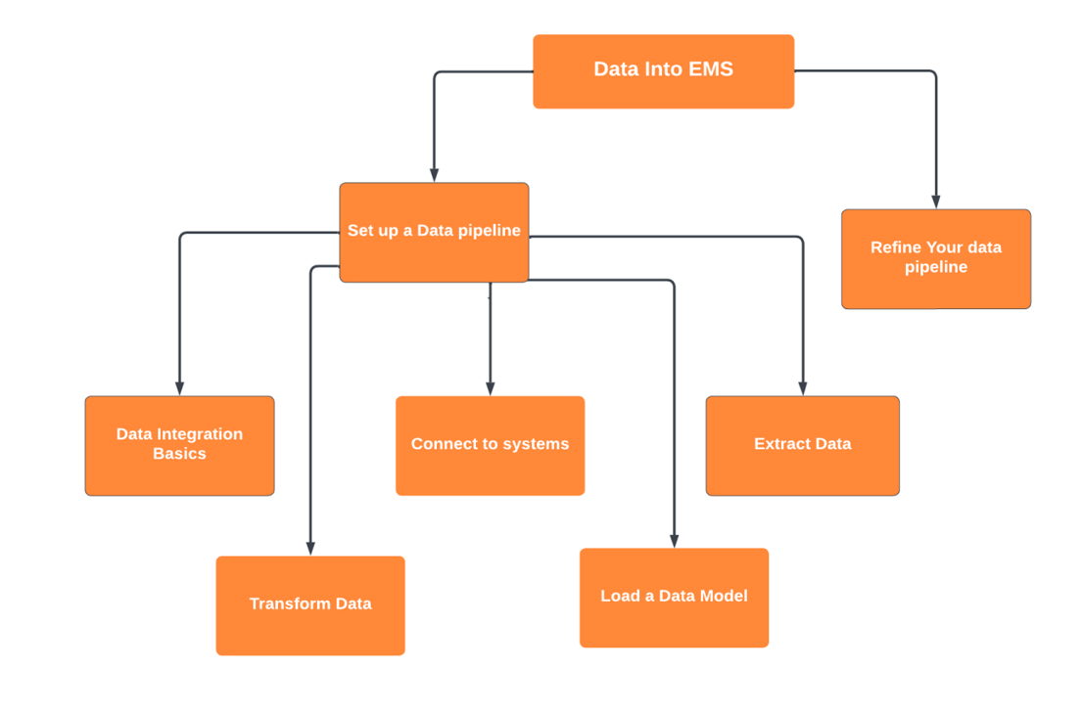
contd..
Get Data into EMS

Slide 19
Contd..
Data Integration:Data integration is the process of bringing data from disparate sources together to provide users with a unified view. The premise of data integration is to make data more freely available and easier to consume and process by systems and users.
Extract Data:Data extraction is the process of obtaining raw data from a source and replicating that data somewhere else. The raw data can come from various sources, such as a database, Excel spreadsheet, an SaaS platform, web scraping, or others.This can include unstructured data, disparate types of data, or simply data that is poorly organized.
Transform data: Data transformation is used when data needs to be converted to match that of the destination system. This can occur at two places of the data pipeline. First, organizations with on-site data storage use an extract, transform, load, with the data transformation taking place during the middle ‘transform’ step.

Slide 20
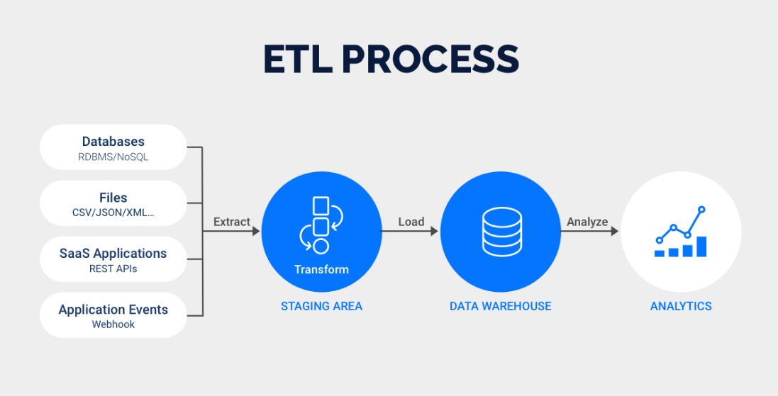
contd..
Data Loading: Data Loading deals with data getting loaded into a storage system, such as a cloud data warehouse. It the process of packing up your data and moving it to a designated data warehouse

Slide 21
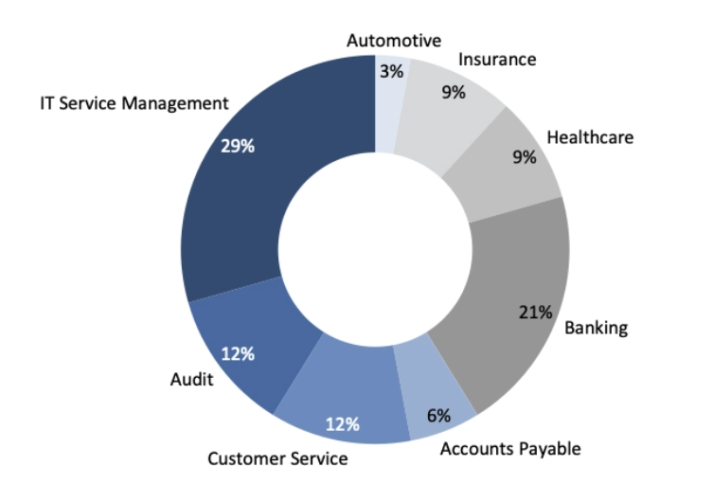
Real Time Applications
Process mining has a wide range of real-world applications across various industries. Here are some notable examples:
Finance
Automative
Banking
Education
Healthcare
Insurance
Digital Transformation
Information and technology

Slide 22
Learning Outcomes
Understand the role of Big data in today’s society
Have a good understanding of Process mining.
Be able to relate process mining techniques to other analysis techniques such as simulation, data mining and machine learning.
Be able to apply basic process discovery techniques to learn a process model from an event log.
Have a good understanding of the data needed to start a process mining project.
Be able to get the basic knowledge of the PQL and understand about the difference between PQL/SQL
Understanding process behaviour and it’s applications in day life.

Slide 23
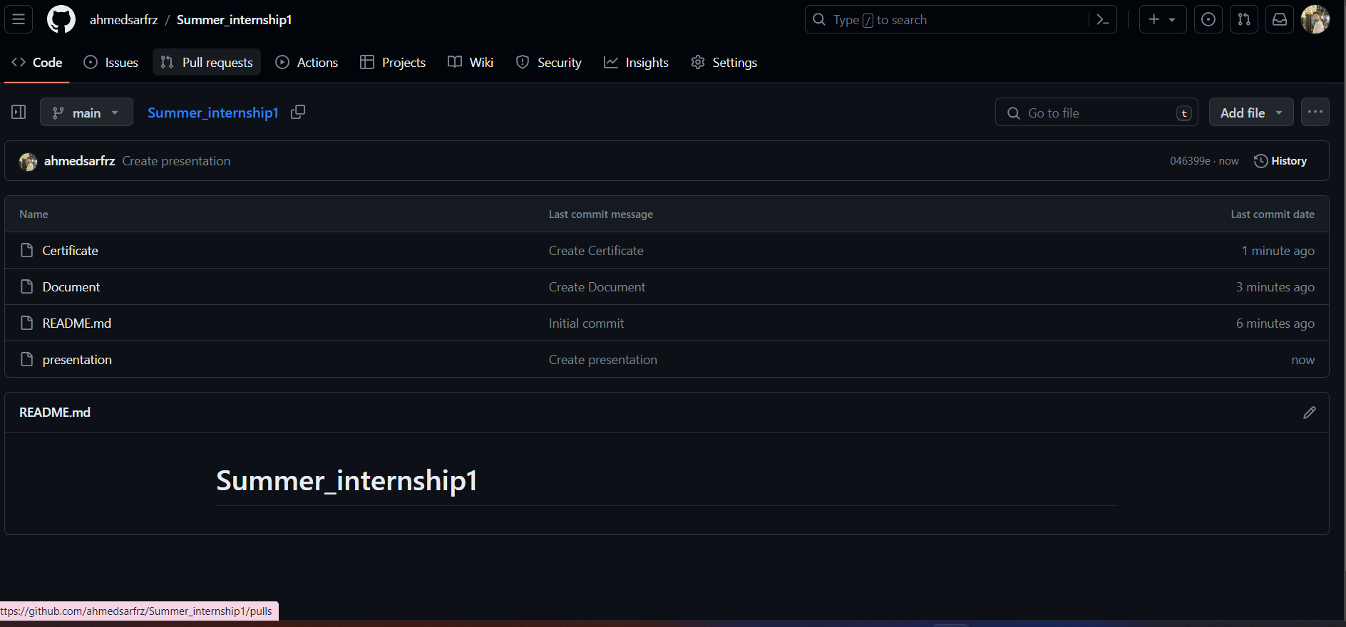

Git Hub Dashboard
Github Link clickhere

Slide 24
Any Queries?

Slide 25
Thank You!!!

